Slide 1
Exploiting domain and task regularities for robust named entity recognition
Ph.D. thesis proposal
Andrew O. Arnold
Machine Learning Department
Carnegie Mellon University
December 5, 2008
Thesis committee:
William W. Cohen (CMU), Chair
Tom M. Mitchell (CMU)
Noah A. Smith (CMU)
ChengXiang Zhai (UIUC)

Slide 2
Outline
Overview
  Problem definition, goals and motivation
Preliminary work:
  Feature hierarchies
  Structural frequency features
  Snippets
Proposed work:
  Cross-task & cross-domain learning
  Relating external and derived knowledge
  Combining & verifying techniques

Slide 3
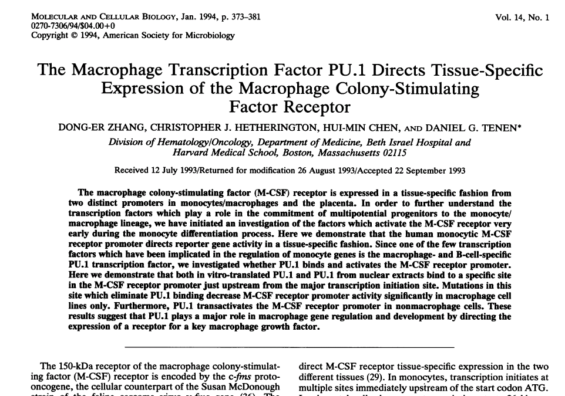
Domain: Biological publications

Slide 4
Problem: Protein-name extraction

Slide 5
Overview
What we are able to do:
  Train on large, labeled data sets drawn from same distribution as testing data
What we would like to be able do:
  Make learned classifiers more robust to shifts in domain and task
    Domain: Distribution from which data is drawn: e.g. abstracts, e-mails, etc
    Task: Goal of learning problem; prediction type: e.g. proteins, people
How we plan to do it:
  Leverage data (both labeled and unlabeled) from related domains and tasks
      Target: Domain/task we’re ultimately interested in
        data scarce and labels are expensive, if available at all
      Source: Related domains/tasks
        lots of labeled data available
  Exploit stable regularities and complex relationships between different aspects of that data

Slide 6
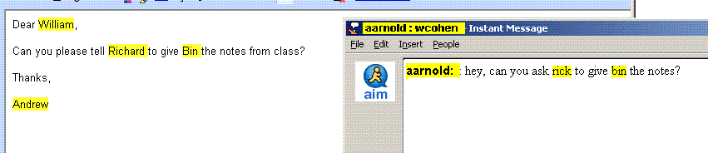
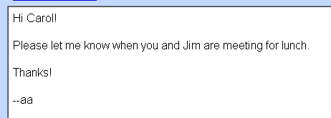
What we are able to do:
Supervised, non-transfer learning
  Train on large, labeled data sets drawn from same distribution as testing data
  Well studied problem
Training data:
Test:
Test:
Train:
Reversible histone acetylation changes the chromatin structure and can modulate gene transcription. Mammalian histone deacetylase 1 (HDAC1)
The neuronal cyclin-dependent kinase p35/cdk5 comprises a catalytic subunit (cdk5) and an activator subunit (p35)

Slide 7
What we would like to be able to do:
Transfer learning (domain adaptation):
  Leverage large, previously labeled data from a related domain
    Related domain we’ll be training on (with lots of data): Source
    Domain we’re interested in and will be tested on (data scarce): Target
      [Ng ’06, Daumé ’06, Jiang ’06, Blitzer ’06, Ben-David ’07, Thrun ’96]
Train (source domain: E-mail):
Test (target domain: IM):
Test (target domain: Caption):
Train (source domain: Abstract):
Neuronal cyclin-dependent kinase p35/cdk5 (Fig 1, a) comprises a catalytic subunit (cdk5, left panel) and an activator subunit (p35, fmi #4)
The neuronal cyclin-dependent kinase p35/cdk5 comprises a catalytic subunit (cdk5) and an activator subunit (p35)

Slide 8
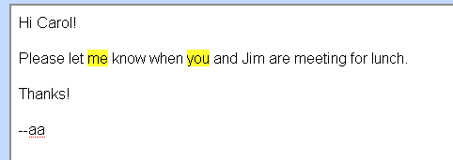
What we’d like to be able to do:
Transfer learning (multi-task):
    Same domain, but slightly different task
    Related task we’ll be training on (with lots of data): Source
    Task we’re interested in and will be tested on (data scarce): Target
      [Ando ’05, Sutton ’05]
Train (source task: Names):
Test (target task: Pronouns):
Test (target task: Action Verbs):
Train (source task: Proteins):
Reversible histone acetylation changes the chromatin structure and can modulate gene transcription. Mammalian histone deacetylase 1 (HDAC1)
The neuronal cyclin-dependent kinase p35/cdk5 comprises a catalytic subunit (cdk5) and an activator subunit (p35)

Slide 9
How we’ll do it: Relationships

Slide 10
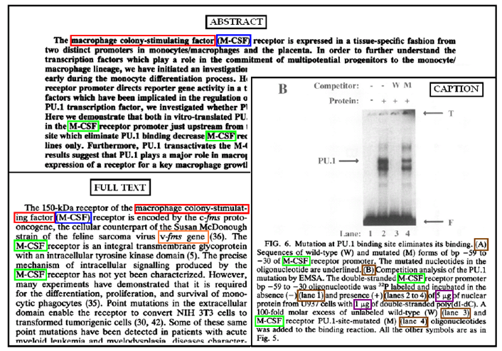
How we’ll do it: Related tasks
full protein name
abbreviated protein name
parenthetical abbreviated protein name
Image pointers (non-protein parenthetical)
      genes
      units

Slide 11
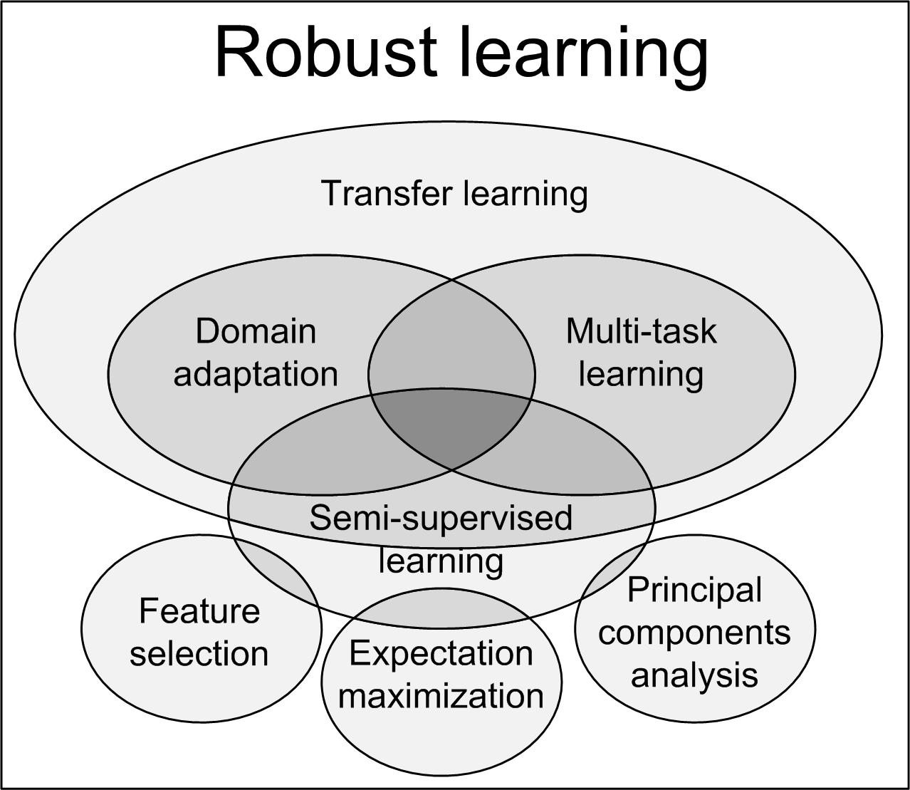

Slide 12
Motivation
Why is robustness important?
  Often we violate non-transfer assumption without realizing. How much data is truly identically distributed (the i.d. from i.i.d.)?
    E.g. Different authors, annotators, time periods, sources
Why are we ready to tackle this problem now?
  Large amounts of labeled data & trained classifiers already exist
    Can learning be made easier by leveraging related domains and tasks?
    Why waste data and computation?
Why is structure important?
  Need some way to relate different domains to one another, e.g.:
    Gene ontology relates genes and gene products
    Company directory relates people and businesses to one another

Slide 13
Outline
Overview
  Problem definition, goals and motivation
Preliminary work:
  Feature hierarchies
  Structural frequency features
  Snippets
Proposed work:
  Cross-task & cross-domain learning
  Relating external and derived knowledge
  Combining & verifying techniques

Slide 14
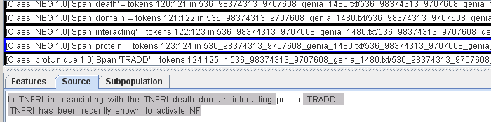
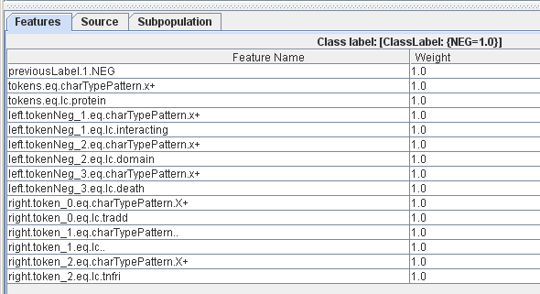
State-of-the-art features: Lexical

Slide 15
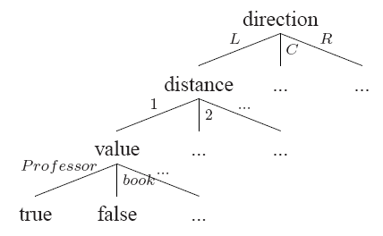
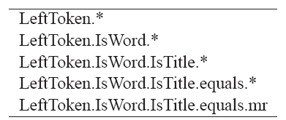
Feature Hierarchy
(Arnold, Nallapati and Cohen, ACL 2008)
Sample sentence:
Give the book to Professor Caldwell
Examples of the feature hierarchy: Hierarchical feature tree for ‘Caldwell’:

Slide 16
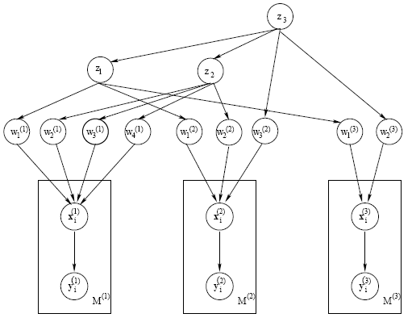
Hierarchical prior model (HIER)
Top level: z, hyperparameters, linking related features
Mid level: w, feature weights per each domain
Low level: x, y, training data:label pairs for each domain

Slide 17
Relationship: feature hierarchies

Slide 18
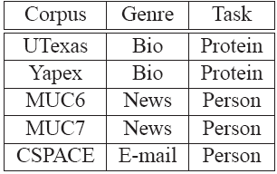
Data
<prot> p38 stress-activated protein kinase </prot> inhibitor reverses <prot> bradykinin B(1) receptor </prot>-mediated component of inflammatory hyperalgesia.
<Protname>p35</Protname>/<Protname>cdk5 </Protname> binds and phosphorylates <Protname>beta-catenin</Protname> and regulates <Protname>beta-catenin </Protname> / <Protname>presenilin-1</Protname> interaction.
Corpora come from three genres:
  Biological journal abstracts
  News articles
  Personal e-mails
Two tasks:
  Protein names in biological abstracts
  Person names in news articles and e-mails
Variety of genres and tasks allows us to:
  evaluate each method’s ability to generalize across and incorporate information from a wide variety of domains, genres and tasks

Slide 19
Experiments
Compared HIER against three baselines:
  GAUSS: CRF tuned on single domain’s data
    Standard N(0,1) prior (i.e., regularized towards zero)
  CAT: CRF tuned on concatenation of multiple domains’ data, using standard N(0,1) prior
  CHELBA: CRF model tuned on one domain’s data, regularized towards prior trained on source domain’s data:
Since few true positives, focused on:
  F1 := (2 * Precision * Recall) / (Precision + Recall)

Slide 20
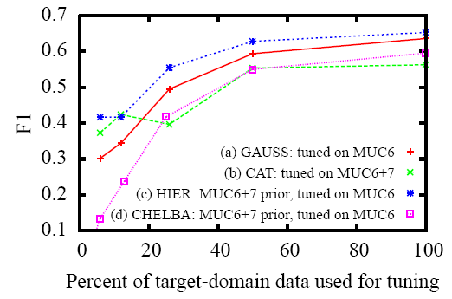
Results: Intra-genre, same-task transfer
  Adding relevant HIER prior helps compared to GAUSS (c > a)
  Simply CAT’ing or using CHELBA can hurt (d ≈ b < a)
  And never beat HIER (c > b ≈ d)

Slide 21
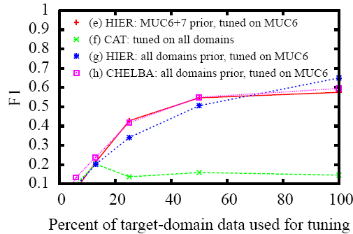
Results: Inter-genre, multi-task transfer
  Transfer-aware priors CHELBA and HIER filter irrelevant data
  Adding irrelevant data to priors doesn’t hurt (e ≈ g ≈ h)
  But simply CAT’ing it is disastrous (f << e)

Slide 22
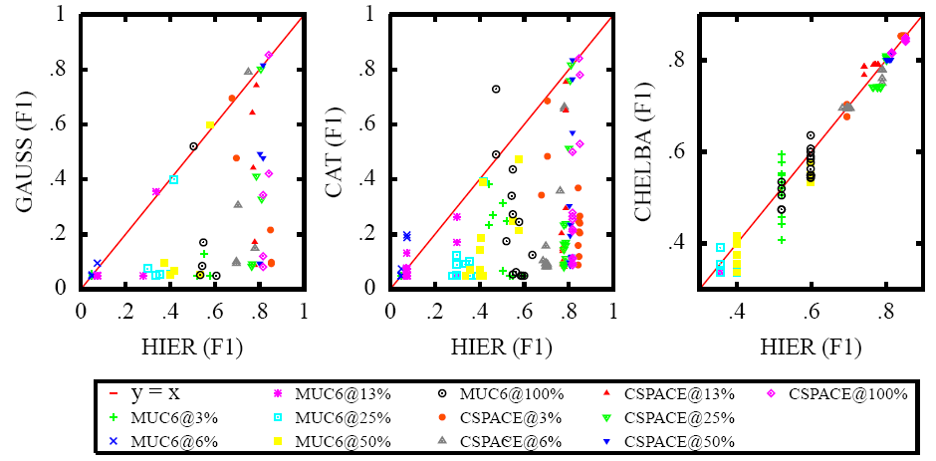
Results: Baselines vs. HIER
  Points below Y=X indicate HIER outperforming baselines
    HIER dominates non-transfer methods (GUASS, CAT)
    Closer to non-hierarchical transfer (CHELBA), but still outperforms

Slide 23
Conclusions
Hierarchical feature priors successfully
  exploit structure of many different natural language feature spaces
  while allowing flexibility (via smoothing) to transfer across various distinct, but related domains, genres and tasks
New Problem:
  Exploit structure not only in features space, but also in data space
    E.g.: Transfer from abstracts to captions of papers From Headers to Bodies of e-mails

Slide 24
Transfer across document structure:
Abstract: summarizing, at a high level, the main points of the paper such as the problem, contribution, and results.
Caption: summarizing the figure it is attached to. Especially important in biological papers (~ 125 words long on average).
Full text: the main text of a paper, that is, everything else besides the abstract and captions.

Slide 25
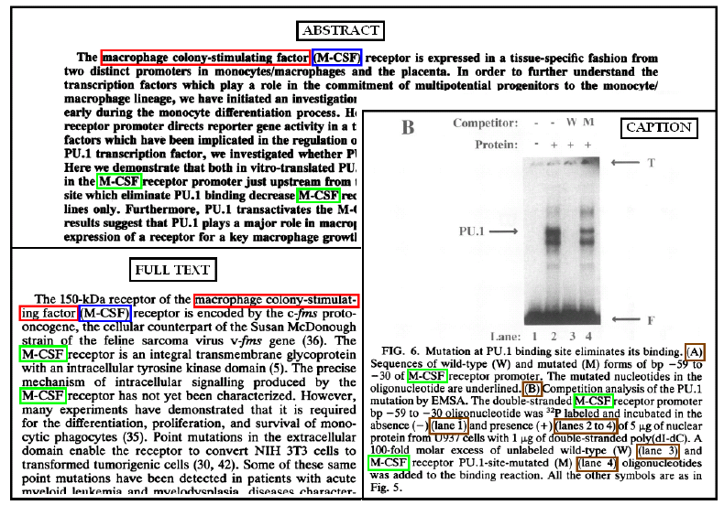
Sample biology paper
full protein name (red),
abbreviated protein name (green)
parenthetical abbreviated protein name (blue)
non-protein parentheticals (brown)

Slide 26
Structural frequency features
(Arnold and Cohen, CIKM 2008)
Insight: certain words occur more or less often in different parts of document
  E.g. Abstract: “Here we”, “this work”
  Caption: “Figure 1.”, “dyed with”
Can we characterize these differences?
  Use them as features for extraction?

Slide 27
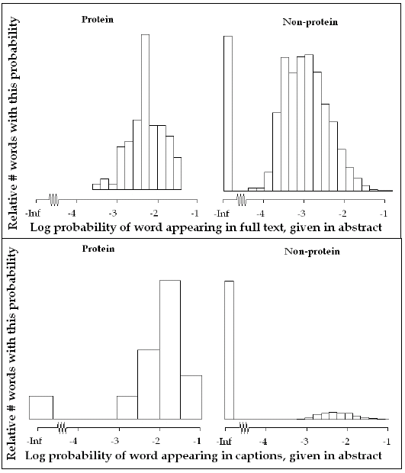
YES! Characterizable difference between distribution of protein and non-protein words across sections of the document

Slide 28
Relationship: intra-document structure

Slide 29
Snippets
(Arnold and Cohen, CIKM 2008)
Tokens or short phrases taken from one of the unlabeled sections of the document and added to the training data, having been automatically positively or negatively labeled by some high confidence method.
  Positive snippets:
    Match tokens from unlabelled section with labeled tokens
    Leverage overlap across domains
    Relies on one-sense-per-discourse assumption
    Makes target distribution “look” more like source distribution
  Negative snippets:
    High confidence negative examples
    Gleaned from dictionaries, stop lists, other extractors
    Helps “reshape” target distribution away from source

Slide 30
Relationship: high-confidence predictions

Slide 31
Data
Our method requires:
  Labeled source data (GENIA abstracts)
  Unlabelled target data (PubMed Central full text)
Of 1,999 labeled GENIA abstracts, 303 had full-text (pdf) available free on PMC
  Nosily extracted full text from pdf’s
  Automatically segmented in abstracts, captions and full text
    218 papers train (1.5 million tokens)
    85 papers test (640 thousand tokens)

Slide 32
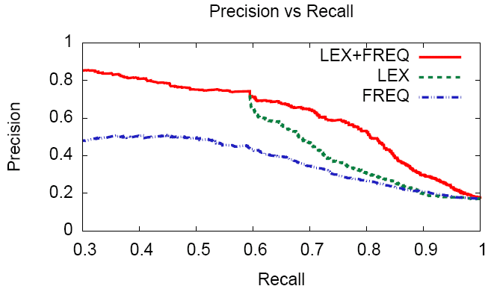
Performance: abstract → abstract
Precision versus recall of extractors trained on full papers and evaluated on abstracts using models containing:
  only structural frequency features (FREQ)
  only lexical features (LEX)
  both sets of features (LEX+FREQ).

Slide 33
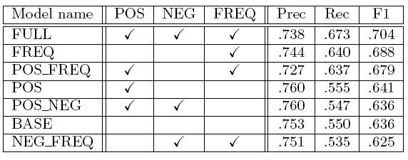
Performance: abstract → abstract
Ablation study results for extractors trained on full papers and evaluated on abstracts
  POS/NEG = positive/negative snippets

Slide 34
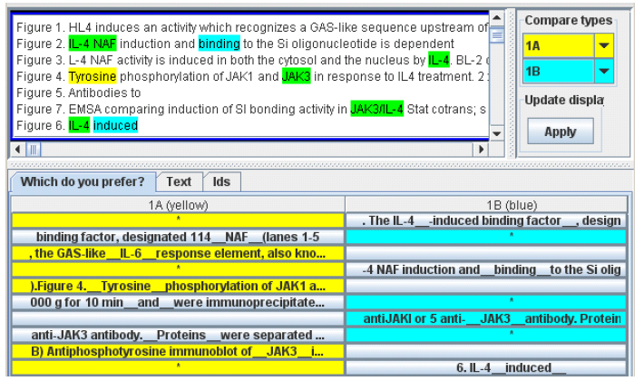
Performance: abstract →captions
How to evaluate?
  No caption labels
  Need user preference study:
Users preferred full (POS+NEG+FREQ) model’s extracted proteins over baseline (LEX) model (p = .00036, n = 182)

Slide 35
Conclusions
Structural frequency features alone have significant predictive power
  more robust to transfer across domains (e.g., from abstracts to captions) than purely lexical features
Snippets, like priors, are small bits of selective knowledge:
  Relate and distinguish domains from each other
  Guide learning algorithms
  Yet relatively inexpensive
Combined (along with lexical features), they significantly improve precision/recall trade-off and user preference
Robust learning without labeled target data is possible, but seems to require some other type of information joining the two domains (that’s the tricky part):
  E.g. Feature hierarchy, document structure, snippets

Slide 36
Outline
Overview
  Problem definition, goals and motivation
Preliminary work:
  Feature hierarchies
  Structural frequency features
  Snippets
Proposed work:
  Cross-task & cross-domain learning
  Relating external and derived knowledge
  Combining & verifying techniques

Slide 37
Proposed work
What other stable relationships and regularities?
  many more related tasks, features, labels and data
How to use many sources of external knowledge?
  Integrate external sources with derived knowledge
  Surrogate for violated assumptions
Combine techniques
  Verify efficacy in well-constrained domain

Slide 38
Cross-task & cross-domain learning
Domain adaptation:
  cell::abstract → cell::caption
Multi-task learning:
  Protein → cell
    Can multiple simultaneous multi-task learning improve robustness?
      Same domain: protein::abstract → cell::abstract
      Cross domain: protein::abstract → cell::caption
        Relate cells and captions to each using biological knowledge
        Similar idea to one-sense-per-discourse inductive bias

Slide 39
Parallel labels
Image pointers & measurement units
  Parenthetical protein mentions and image pointers look similar
  Image pointers are sometimes easier to identify
    By identifying one can help identify others
  Measurement units and proteins are mutually exclusive
    By identifying one can exclude others, reduce false positives
Image and experiment type
  Images and captions related to experiment they describe
    Related experiments should have related properties

Slide 40
Relating external and derived knowledge
External data sources
  Gene ontology, citation networks
Hard labels
  High confidence, high precision
    Dictionaries, gazetteers
  Low recall, expensive
Soft labels
  Low confidence, high recall
    Curator, weak learner,
  Cheap, low precision

Slide 41
Combining & verifying techniques
Combining techniques
  Intelligently use relationships and regularities to
    Compensate for violated assumptions
    Generally make learners more robust
      E.g., combine noisy image pointer labeler with external knowledge that image pointers and proteins are mutually exclusive to reduce protein false positive
Verifying hypotheses on limited domain
  Yeast protein names trivial to automatically identify
    Golden standard against which to investigate and validate

Slide 42
☺ ¡Thank you! ☺
¿ Questions ?
For details and references please see proposal document:
  http://www.cs.cmu.edu/~aarnold/thesis/aarnold_proposal.pdf
and these publications:
  Andrew Arnold and William W. Cohen. Intra-document structural frequency features for semi-supervised domain adaptation. In CIKM 2008.
  Andrew Arnold, Ramesh Nallapati, and William W. Cohen. Exploiting feature hierarchy for transfer learning in named entity recognition. In ACL:HLT 2008.
  Andrew Arnold, Ramesh Nallapati, and William W. Cohen. A Comparative Study of Methods for Transductive Transfer Learning. ICDM 2007 Workshop on Mining and Management of Biological Data.

